Slide 1



Smart India Hackathon
Problem Statement: Accurate Forecasting of Water Requirements and Storage Capabilities
Ministry/Organization: Ministry of Jal Shakti
Problem Statement Code: SIH-1692
Team Name: Team Bharati
Team Leader: Durgesh Keshri
AISHE Code: C-70718
Institute Name: Bharati Vidyapeeth (Deemed to be University), Department of Management Studies, Off Campus, Kharghar, Navi Mumbai
Theme Name: Smart Education

Slide 2
Team & Roles
Role Name Stream Year Experience
Team Leader Durgesh Keshri Computer Application 3rd Fullstack Development, Machine Learning
Member 1 Danish Shaikh Computer Application 3rd Fullstack Development, Machine Learning
Member 2 Ashfaque Shaikh Computer Application 3rd Fullstack Development
Member 3 Jyotiraditya Moury Computer Application 3rd Web Development, AI
Member 4 Abhisekh Gupta Computer Application 3rd Backend Development, Data Science
Member 5 Vaishnavi Shinde Computer Application 3rd Fullstack Development

Slide 3
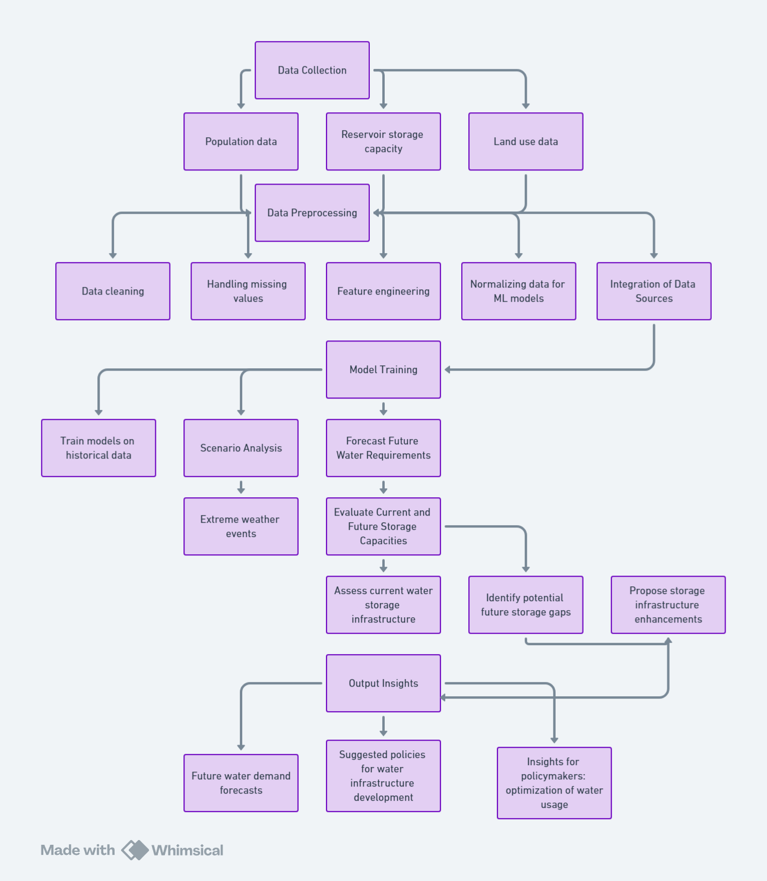

Approach: A Data-Driven Solution
1
Data Collection
Data sources: Historical water usage (sectors like household, agriculture, industry), reservoir capacities, climate data (temperature, rainfall), and population growth trends.
2
Data Preprocessing
Cleaning and normalizing data, handling missing values, and anomaly detection.
3
Machine Learning Model Development
ML algorithms to predict future water demand, assess reservoir capacities, and evaluate risks.

Slide 4
AI-Powered Forecasting
Time-Series Forecasting
Regression Models
Scenario Modeling
ARIMA and LSTM to predict water demand based on historical consumption patterns, climate data, and population growth.
Linear and Polynomial Regression for analyzing key variables like temperature, evaporation, and demographic changes.
Scenario-based models to account for extreme weather events.

Slide 5

Strategic Water Planning
Models predict future water needs under different scenarios.
1
El Niño/La Niña
2
Droughts/Floods
3
Reservoir Soakage and Capacity
Changing rainfall patterns and their impact on water availability.
Extreme weather impacts on water demand and supply.
Predict how much water is absorbed by the earth from reservoirs, providing more accurate data on actual water availability.

Slide 6

Technology & Infrastructure
Data Requirements
Sources: Historic water usage, climate data, population trends, agricultural and industrial data, and reservoir capacities.
Tech Stack
Backend: Flask, Deployment: AWS, Machine Learning: TensorFlow, scikit-learn, pandas, NumPy, Frontend: React.js, Database: MySQL/PostgreSQL, Visualization Tools: D3.js/Chart.js, Mapbox.

Slide 7




Driving Impact with Predictive Water Management
Water Demand Forecasting
Infrastructure Planning
Climate Event Management
Optimization
Use predictions to identify gaps in current storage capacity and guide future infrastructure investments.
Improve water usage efficiency across all sectors by predicting shortfalls and excesses.
Forecasting demand for sectors (household, agriculture, industry) under normal and extreme conditions.
Create scenario-based plans to handle extreme events (floods, droughts) and mitigate risks.

